Slide 1
Transformer加速器
演讲人：杨涛

Slide 2
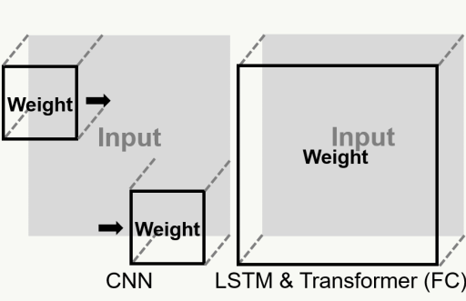
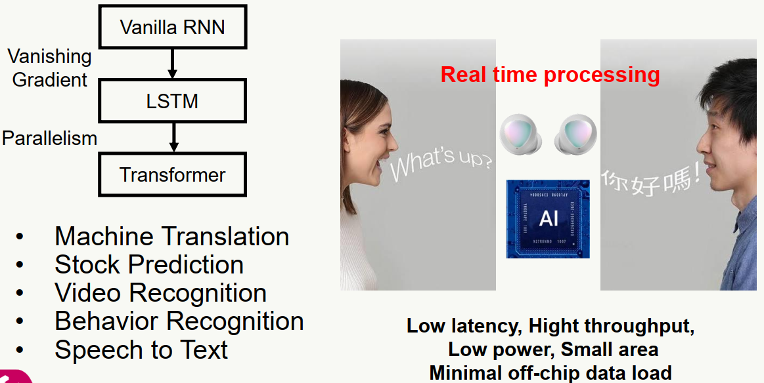
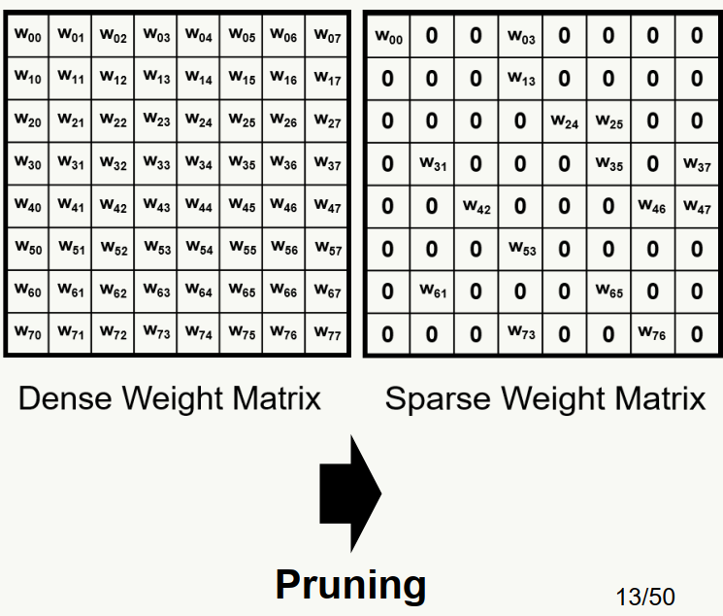
学习情况
Recurrent Neural Networks (RNN) have shown promising results in dealing with sequential data.

Slide 3
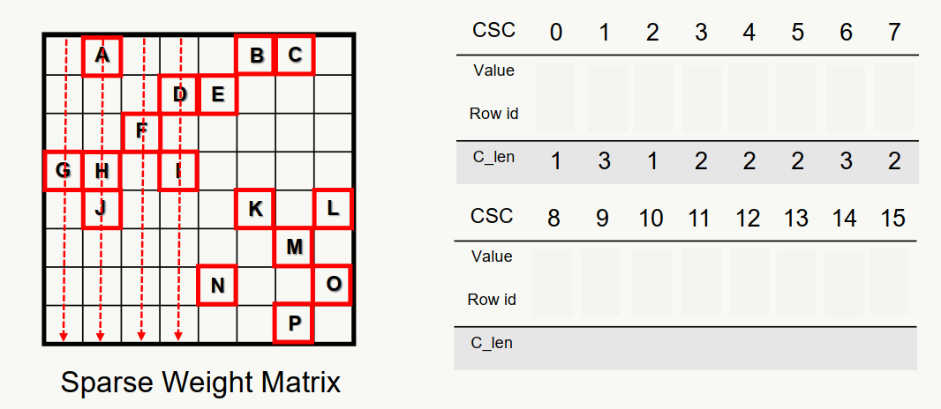
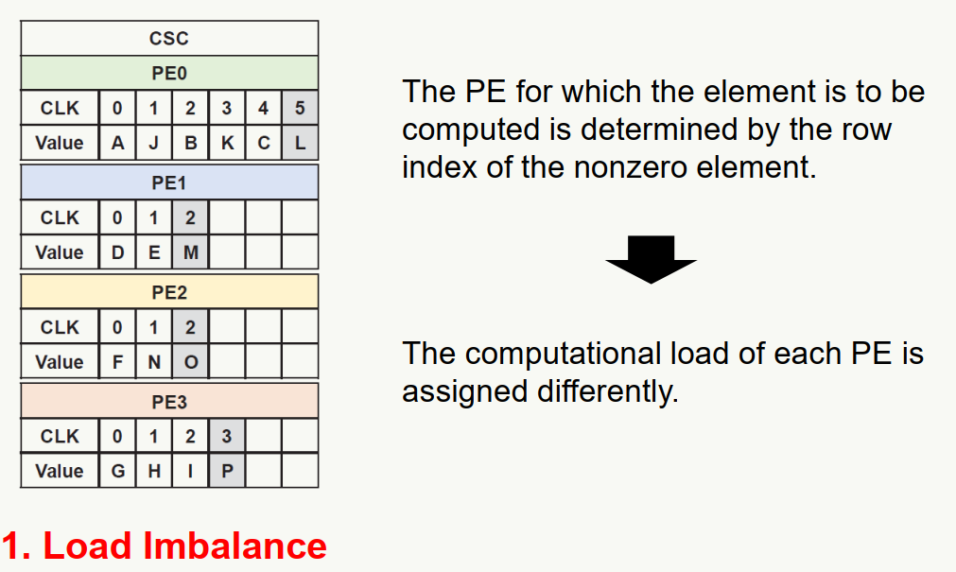
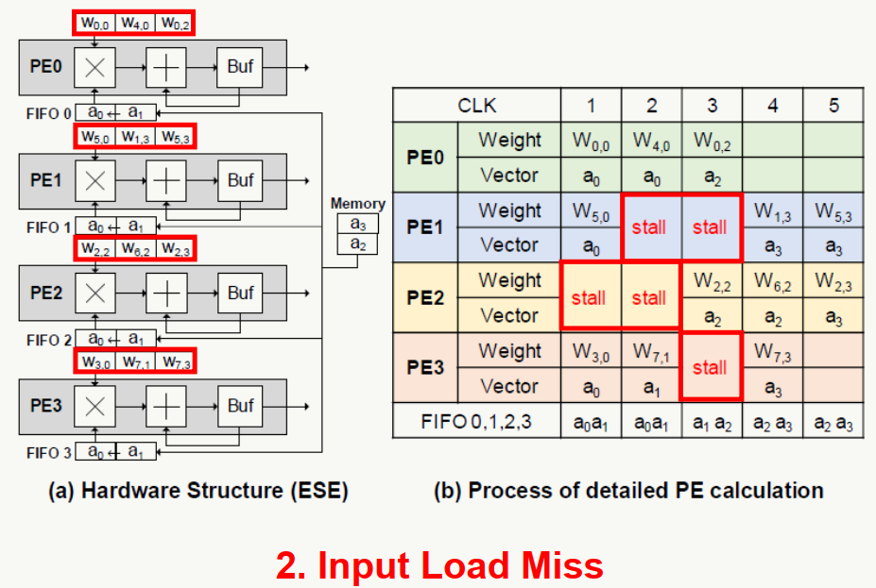
Sparse Matrix Format

Slide 4
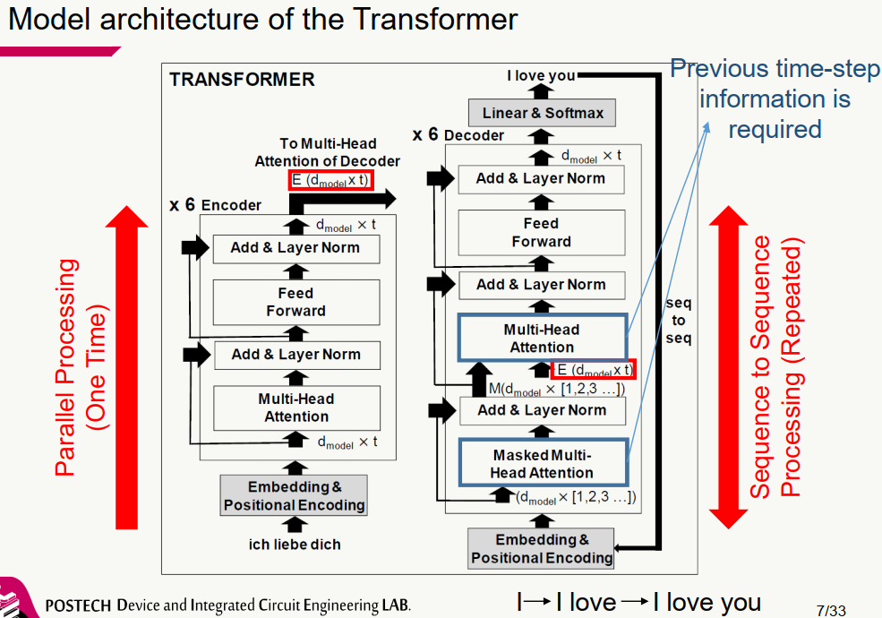
Transformer modle

Slide 5
Sparse Matrix Format

Slide 6
感谢各位老师！
欢迎提问或指正！

